Slide 1
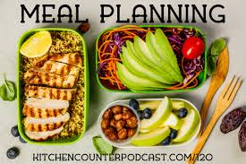
MEAL PLANNING
Dr. Swapna Dutta
HoD, Dept. of Home Science

Slide 2
WHAT IS MEAL PLANNING

Slide 14
Questions
1. What is meal planning?
2 . Write the importance of meal planning?
3. Write the objectives of meal planning?
4. Write the principles of meal planning?

Slide 15
THANK YOU

