Slide 1
Functions, Dietary Sources and clinical manifestations of deficiency/ excess of the following nutrients
Dr. Swapna Dutta
HoD, Dept. of Home Science

Slide 3
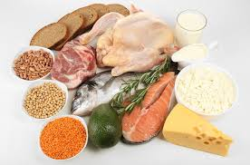

Slide 13
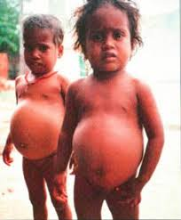

Slide 14
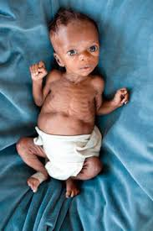

Slide 17
Thank You

